Slide 1
SYLLABUS
SEC-A
MICROECONOMICS:
Definition of economics; Fundamentals of economics; Market and government in a modern economy; Basic elements of supply and demand; Choice and utility; indifference curve technique; Analysis of cost; Short run long run theory of production; Analysis of Market; Optimization; Theory of distribution.

Slide 2
References
Economics by Samuelson
Economics by John Sloman
Economic Development by Michael Todaro

Slide 3
ENGINEERING ECONOMICS
When the economics principles are applied to engg. Problems, then a new branch of knowledge called engineering economics. Engineers have responsibility to include economics in their calculation & decision making.

Slide 4
WHY DO WE CARE ABOUT ENGINEERING ECONOMICS?
Engineering designs are intended to produce good results.
They are accompanied by undesirables (costs).
If outcomes are evaluated in dollars, and “good” is defined as profit, then decisions will be guided by engineering economics.

Slide 5
Why Engineering Economy is Important to Engineers?
Engineers design and create
Designing involves economic decisions
Engineers must be able to incorporate economic analysis into their creative efforts
Often engineers must select and implement from multiple alternatives
Understanding and applying time value of money, economic equivalence, and cost estimation are vital for engineers
A proper economic analysis for selection and execution is a fundamental task of engineering

Slide 6
MEANING OF ECONOMICS
The word “Economics” originates from the Greek word„Oikonomikos‟which can be divided into two parts: (a) „Oikos‟, which means “ home, family, household, or estate”, and(b) „Nomos‟, which means „Management‟.
Thus, Economics means “Home Management” or„ Management of the State.

Slide 7
DEFINITION - ECONOMICS
1. Economics was concern with an inquiry into nature and causes of wealth of nations.
--- Adam Smith
2. Economics is the science which treats of wealth.
--- J B Say
3. Economics is that body of knowledge which relates to wealth.
--- F A Walker

Slide 8
DEFINITION
4. Political Economy/ economics is the study of mankind in the ordinary business of life. It examinees that part of indl and social action which is most closely connected with the attainment and with the use of material requisites of well-being --- Alfred Marshall
5. Economics is the science which studies human behavior as a relationship between ends and scarce means which have alternative uses --- Robbins

Slide 9
DEFINITION - MICROECONOMICS
Microeconomic theory studies the behavior of individual decision making units such as consumers, resource owners and business firms. It is deal with some small part or component of the whole economy. For example, we may be studying an individual consumers behavior or that of an individual firm or what happens to a particular industry.

Slide 10
DEFINITION - MACROECONOMICS
Macroeconomic theory is concern with aggregate and average of the entire economy, such as national income, aggregate output, total employment, total consumption, savings and investment, aggregate demand, aggregate supply, general price level etc. It is also discussed with the economic development and the various stages and process of economic growth.

Slide 11
SCOPE OF ECONOMICS
The subject matter of economics.
Whether economics is a science or an art.
Whether it is a positive or normative science.
Whether it is social science.
Whether it can solve practical problem.

Slide 12

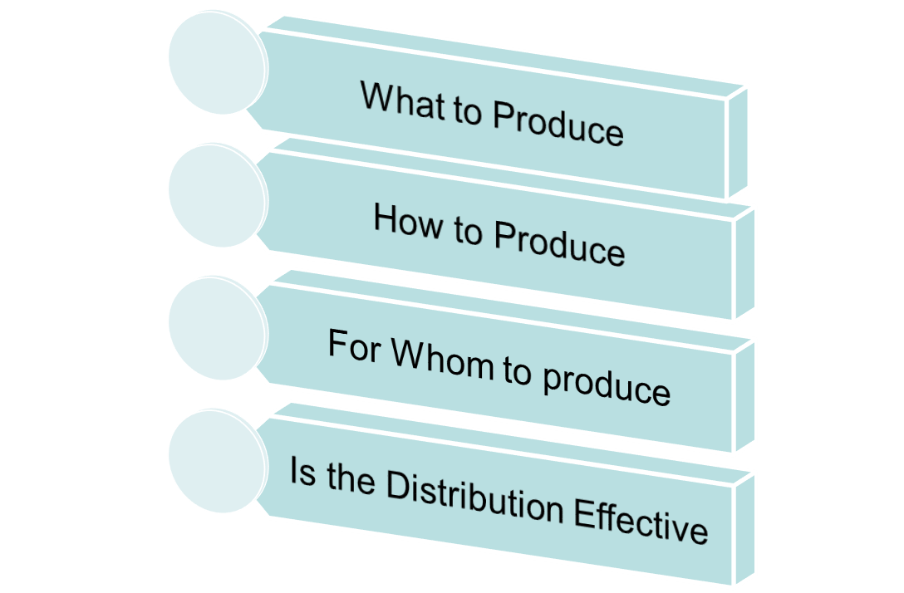

Slide 13

Cloth
A
C
D
O
F
B
E
Food
Fig: PPC Curve

Slide 14

Capital
A
B
D
C
O
E
F
Labor
Fig: ISO Product Curve

Slide 15

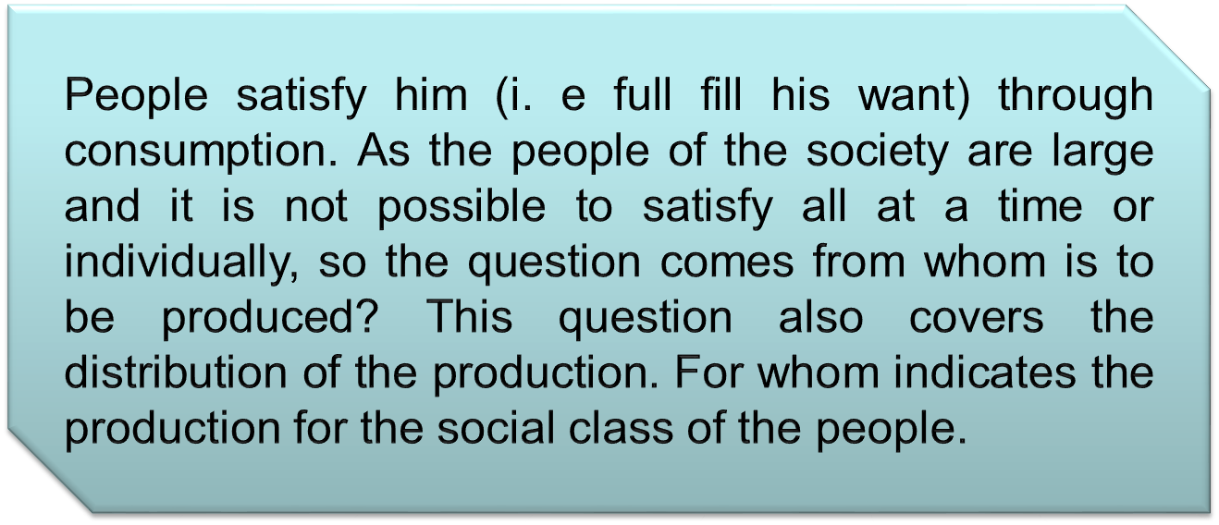

Slide 16

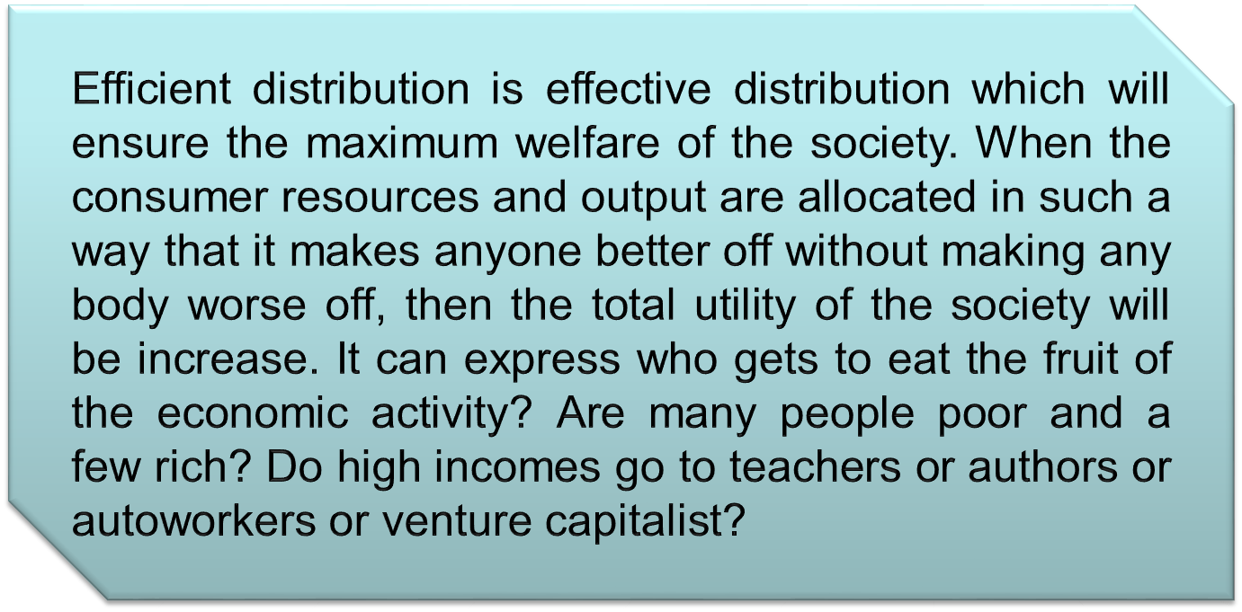

Slide 17
SOLUTION OF THE PROBLEM
Production
Exchange
Distribution
Consumption

Slide 18
SOLUTION OF THE PROBLEM
In a market economy indl and pvt firms make the major decisions about production consumption a system of prices, of markets, of profits and losses, of incentives and rewards determines “What”, “How”, “For Whom” .
In a command economy government owns most of the means of production(Land and Capital); and answers major economic questions through its ownership of resources and its power to enforce decisions.
All economic societies are mixed economies, with element of market and command.

Slide 19
SUMMARY

Slide 20


